Slide 1

PYTHON Mini project :
(TRIPOTO)
PRESENTED BY:
VAMSHIDHAR DUGYALA [1602-20-737-057]
HARSHITH PAGINDLA [1602-20-737-016]
GOPI SATHVIK [1602-20-737-013]

Slide 2

ABSTRACT​:
The main objective of the project is to manage the trip expenses during a trip and to know weather conditions of the destination place. This project is useful for trip people. It is a GUI based application.
In this application, at maximum we can enter 5 trip traveler details and we can add their trip expense details i.e. a traveller can enter details for the what purpose he/she spent at specific time and date. We are allowed to track the expenses at any point of time.
We can know the exact weather conditions like current temperature, humidity, minimum temperature, maximum temperature and graticule location of destination place. ​
weather
Track expenses

Slide 3

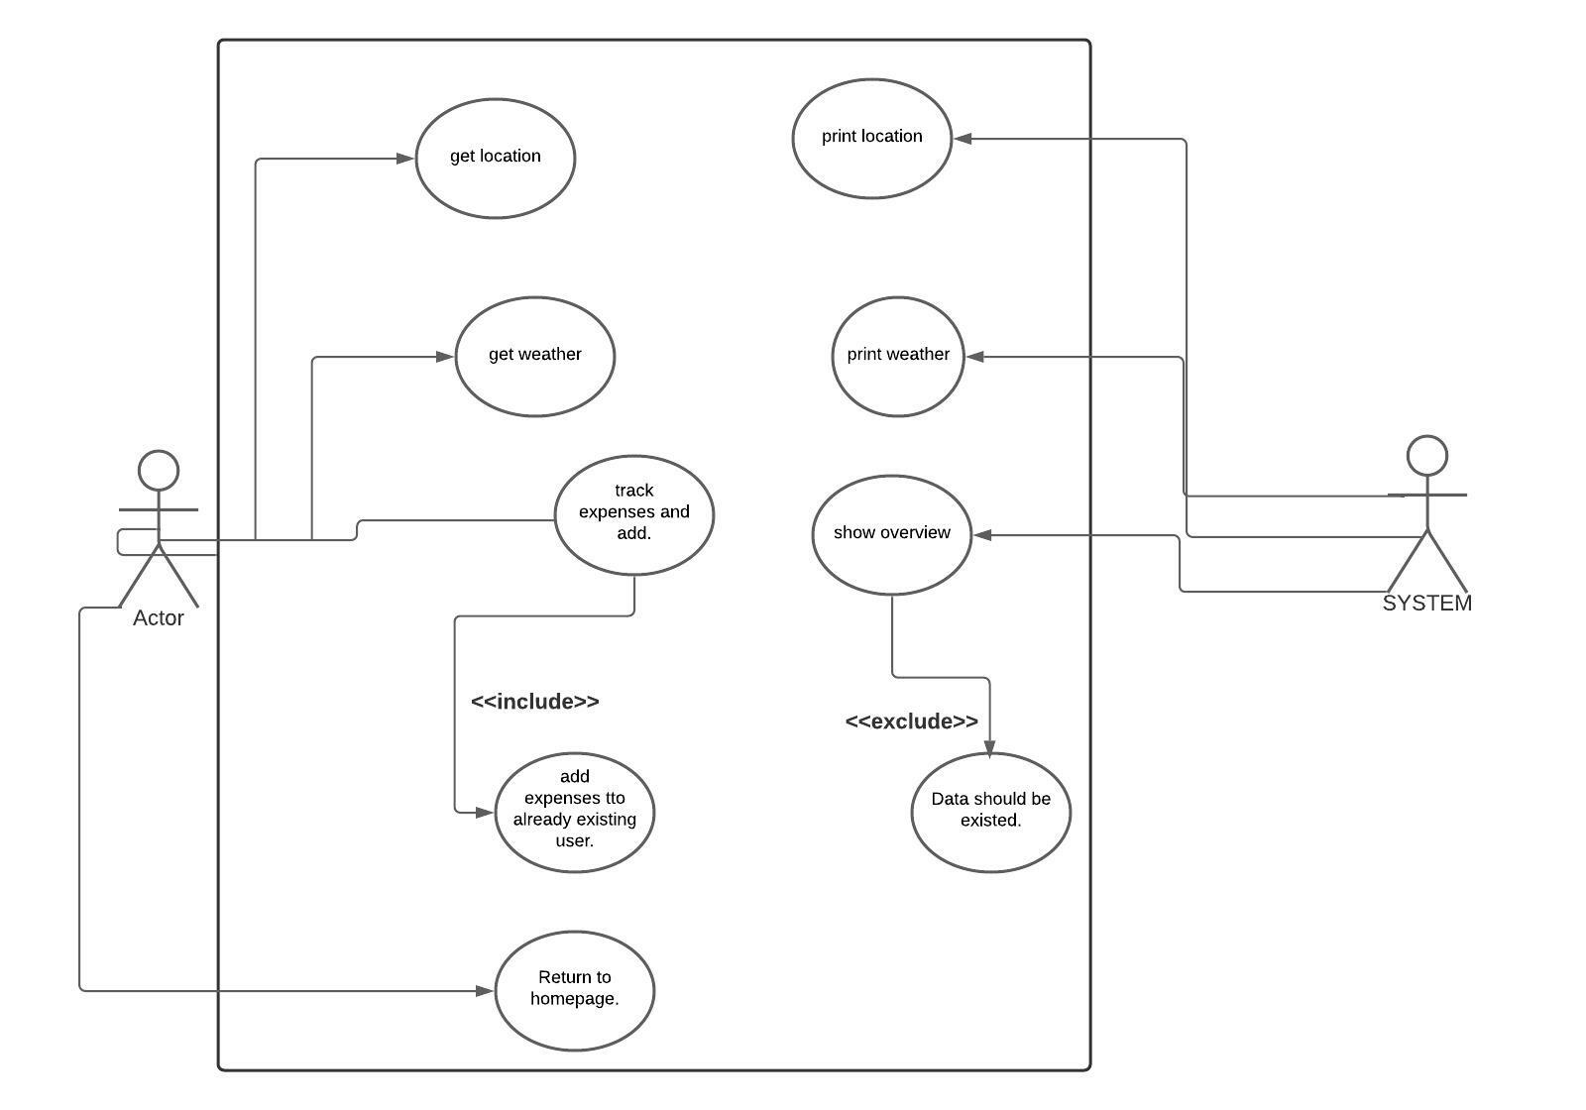
USE CASE DIAGRAM:

Slide 4
TECHNOLOGY USED:​
Kivymd for GUI.
Bs4 module for to know weather conditions.
Requests library to extract specific information.
datetime module is imported to work with the date as well as time.

Slide 5

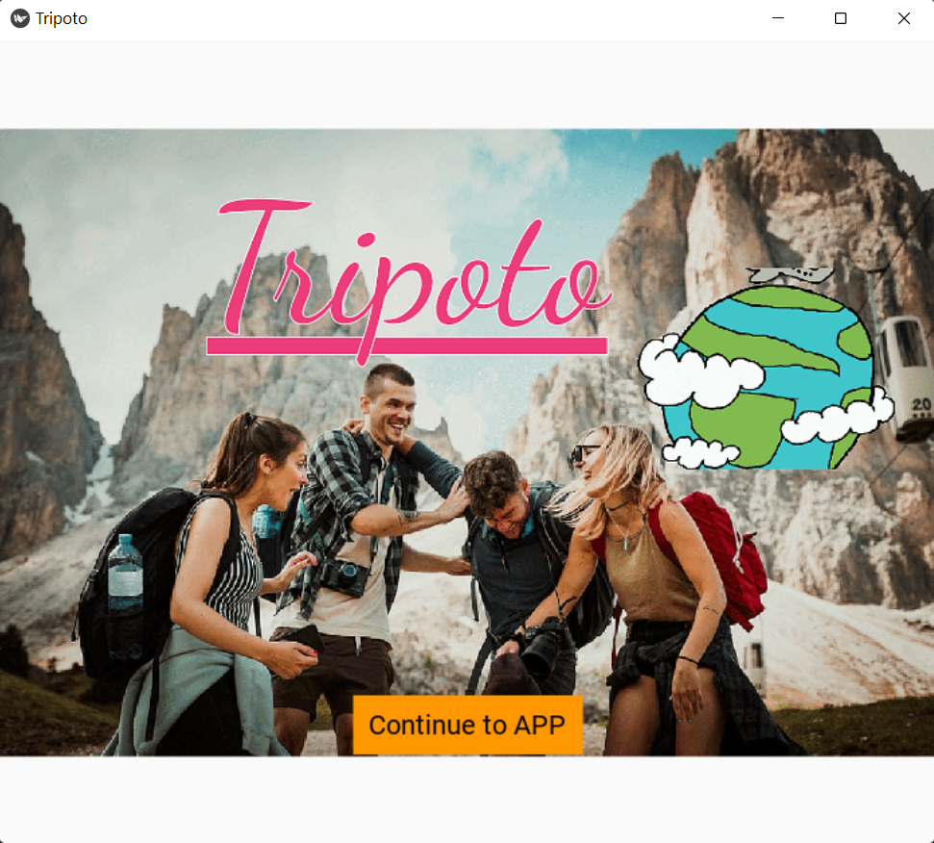
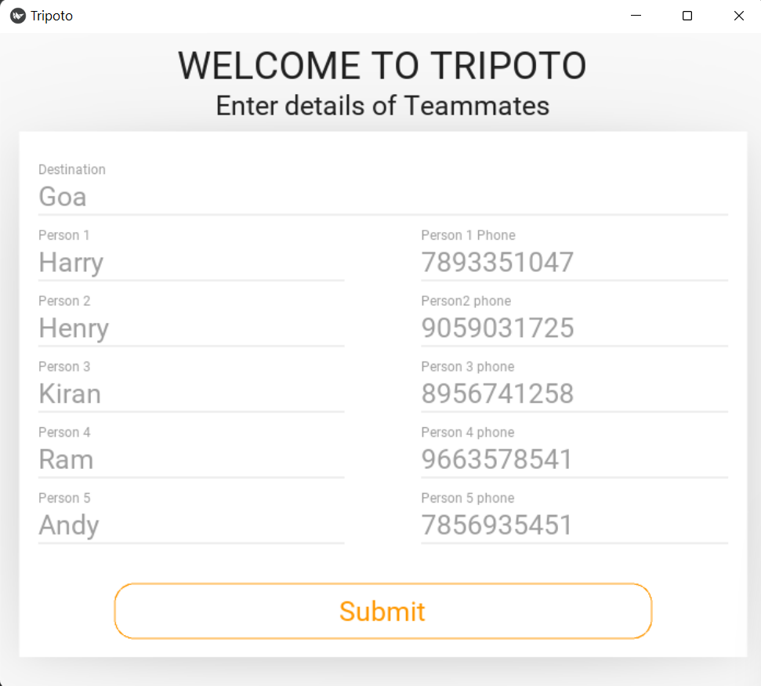
SCREENSHOTS OF EXECUTION:​

Slide 6
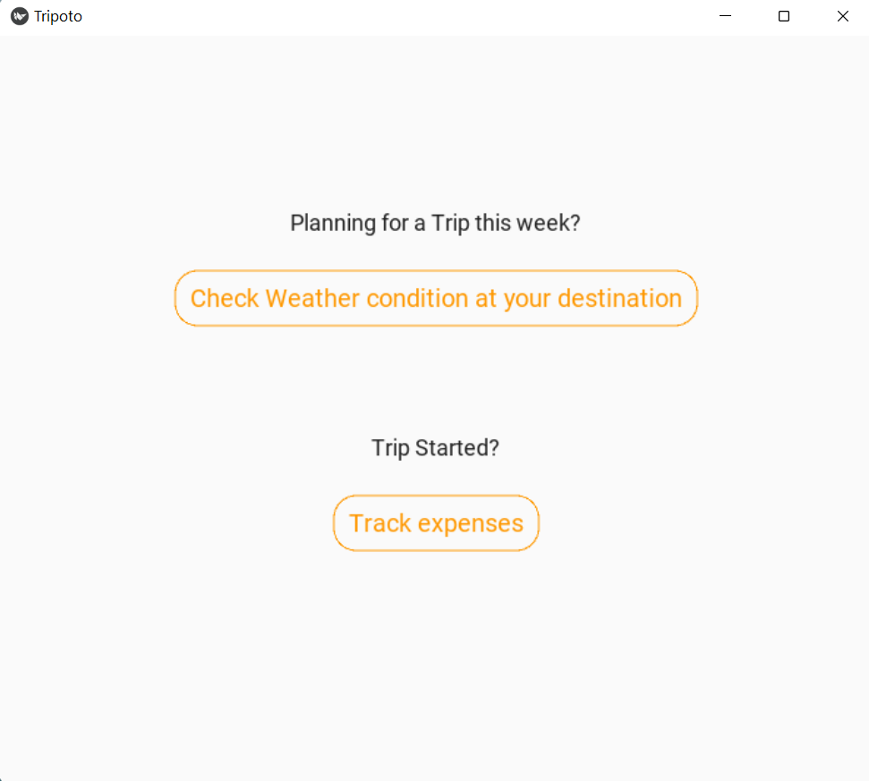
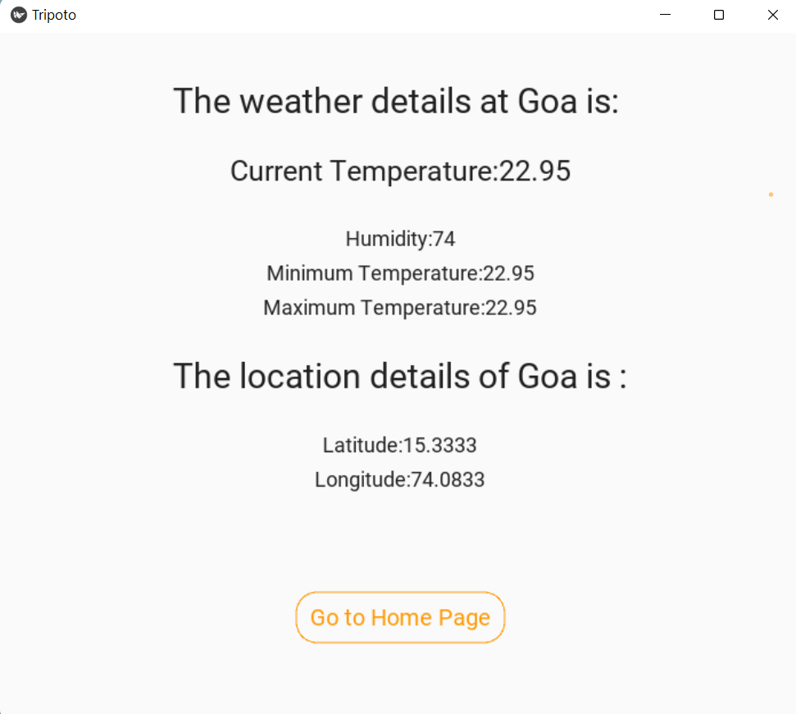
SCREENSHOTS OF EXECUTION:​

Slide 7
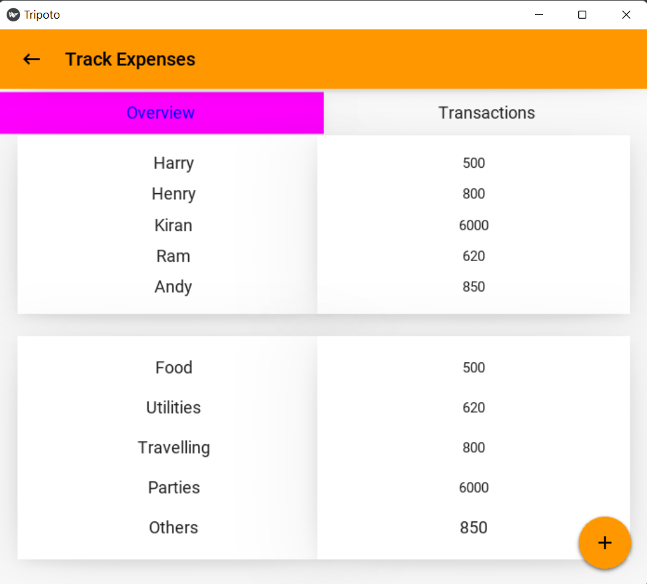
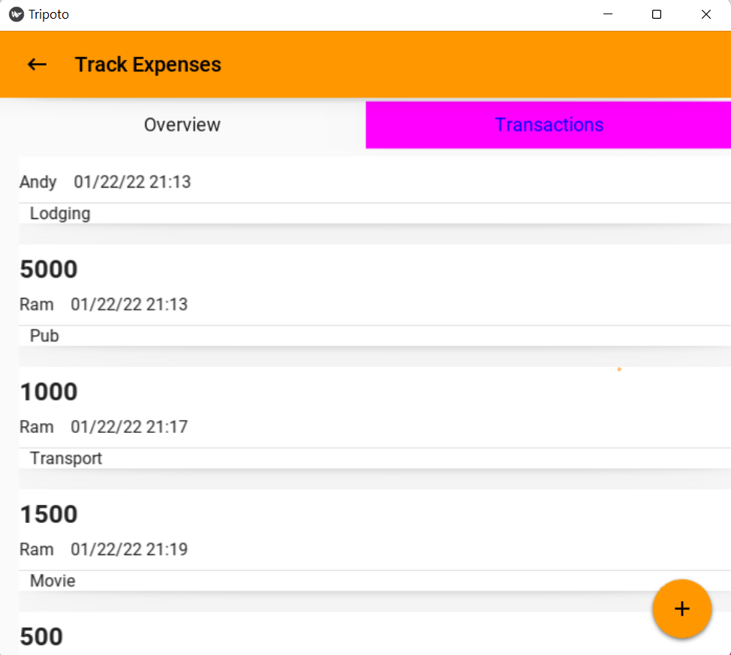
SCREENSHOTS OF EXECUTION:​

Slide 8

FUTURE SCOPE:
Reach for this application will be high, as this gives a solution for the travellers to track thie expensed during a trip and also can be used to analyse daily spends (i.e. for domestic use).
In the coming days the app can be improvised by adding some more features like:
Integrating maps
Artificial intelligence can be used to show the trends of people travelling and details of average money spent by the travellers.

Slide 9


